Slide 1

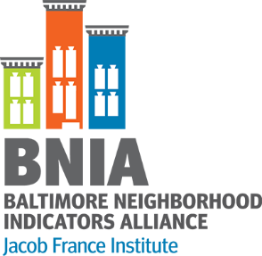
Perkins, Somerset, Old Town Transformation Plan
Data Dashboard Presentation
September 9, 2020
Prepared by:

Slide 2
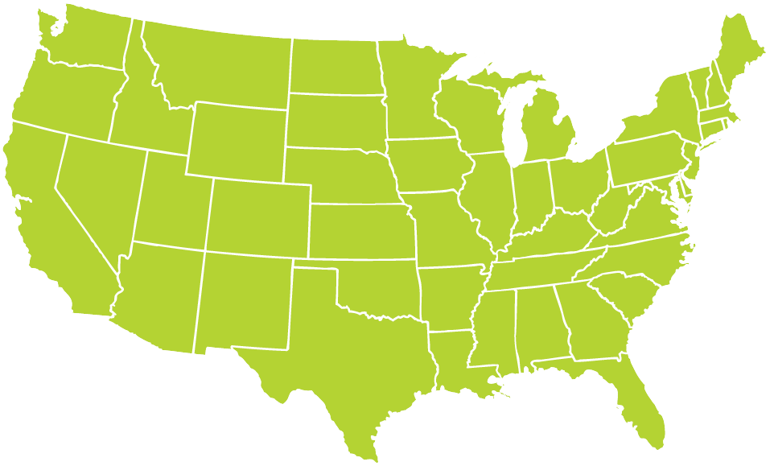
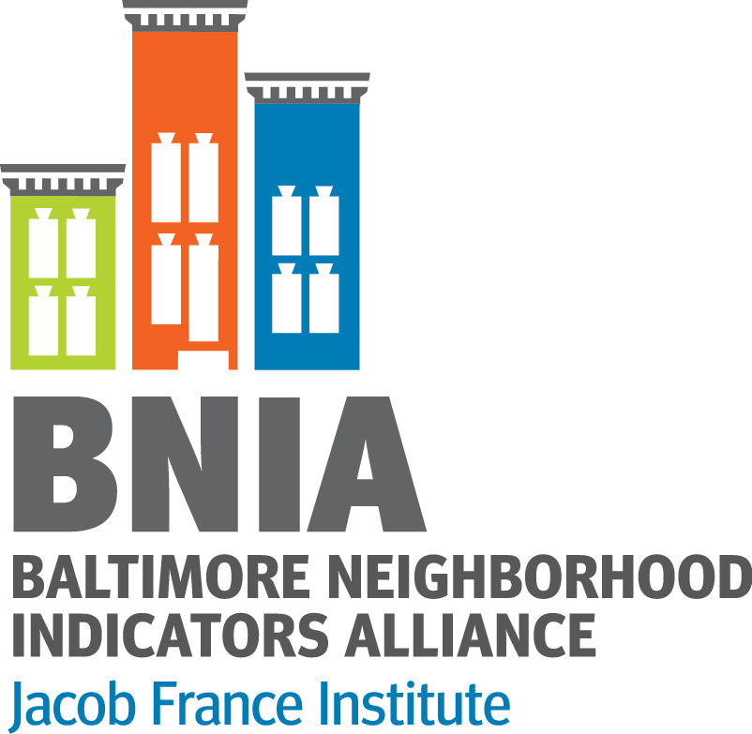

About BNIA-JFI
Self-support research center started about 20 years ago by local stakeholders, housed within Jacob France Institute at University of Baltimore
“One-stop-shop” for comprehensive, reliable data, community indicators and training
    Multiple topic areas
    Longitudinal data (2000 – 2020)
Member of the National Neighborhood Indicators Partnership at the Urban Institute
  30+ cities focusing on data democratization
  http://www.neighborhoodindicators.org

Slide 3
About Perkins Somerset Oldtown Plan
The PSO Transformation Plan calls for the demolition and redevelopment of Perkins Homes into a vibrant mixed income community with affordable and market rate housing, a new 21st Century school, new community amenities and opportunities, neighborhood improvements, and a supportive services plan aimed at helping families meet their goals. For more information about the plan, visit https://www.habc.org/habc-information/programs-departments/planning-development/pso-transformation/
For residents and other stakeholders of the area to keep track of progress over the implementation period, this dashboard will be updated quarterly with key indicators for the project. Indicators were chosen to correspond to each of the project’s three core goals for residents and the overall goal of promoting economic development in the area.
People
Neighborhood
Housing
Economic Impact of the Project

Slide 4
Purpose of the Data Dashboard
How can we use data to help answer questions that residents, businesses and other stakeholders have about the project?
  What questions do people have?
  Which data can be used to track progress?
Add data based on feedback
Collect data on a quarterly basis and ensure accuracy
  Sources include HABC/HUD data, Baltimore Open Data, and other local datasets
Train residents on how to use the dashboard
To view the dashboard to date, visit bniajfi.org/pso

Slide 5
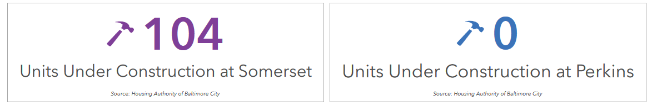
Housing
Goal:
Replace distressed public and assisted housing with high quality mixed-income housing that is well-managed and responsive to the needs of the surrounding neighborhood.

Slide 6
Neighborhood
Goal:
Attract public and private reinvestment in distressed neighborhoods to improve the amenities and assets (ex. safety, good schools, commercial activity) available to the community.
Violent Crime
Property Crime
Vacancy

Slide 7
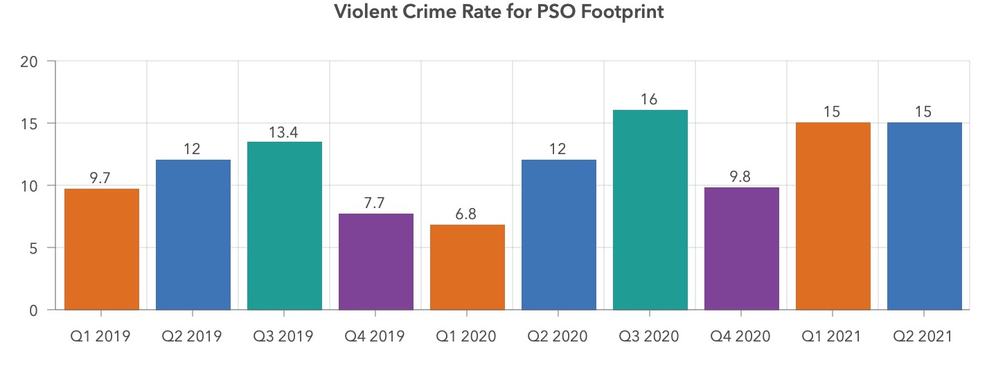
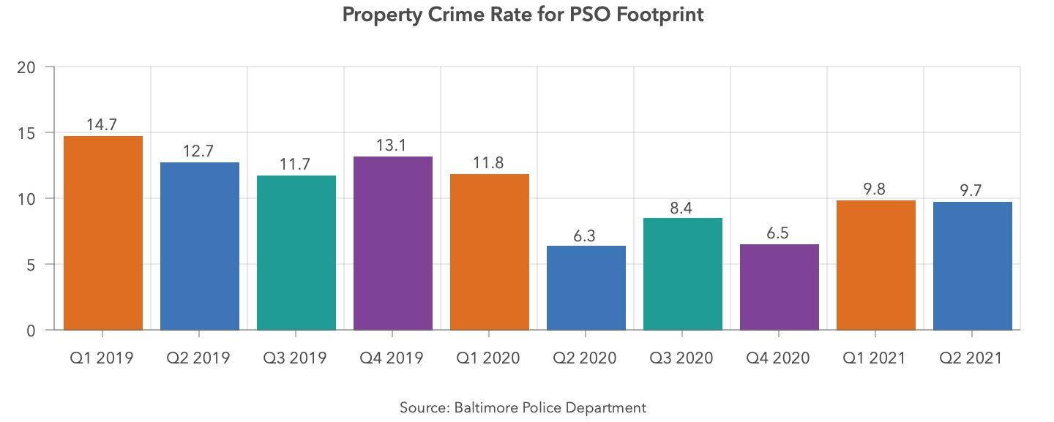
Neighborhood – Crime Per Quarter

Slide 8
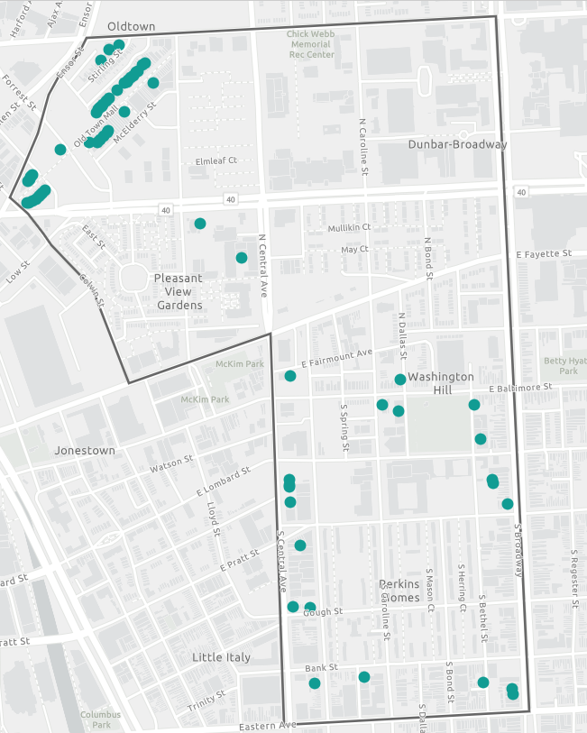
Neighborhood - Vacancy
Properties with Vacant Building Notices (VBNs)
Source: Baltimore Department of Housing and Community Development

Slide 9
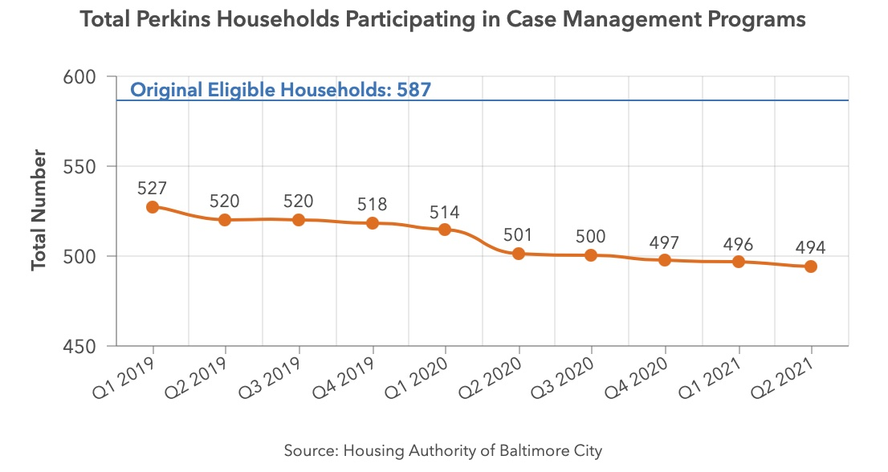
People
Goal:
Improve educational and economic outcomes through supportive services delivered directly to youth and their families.

Slide 10
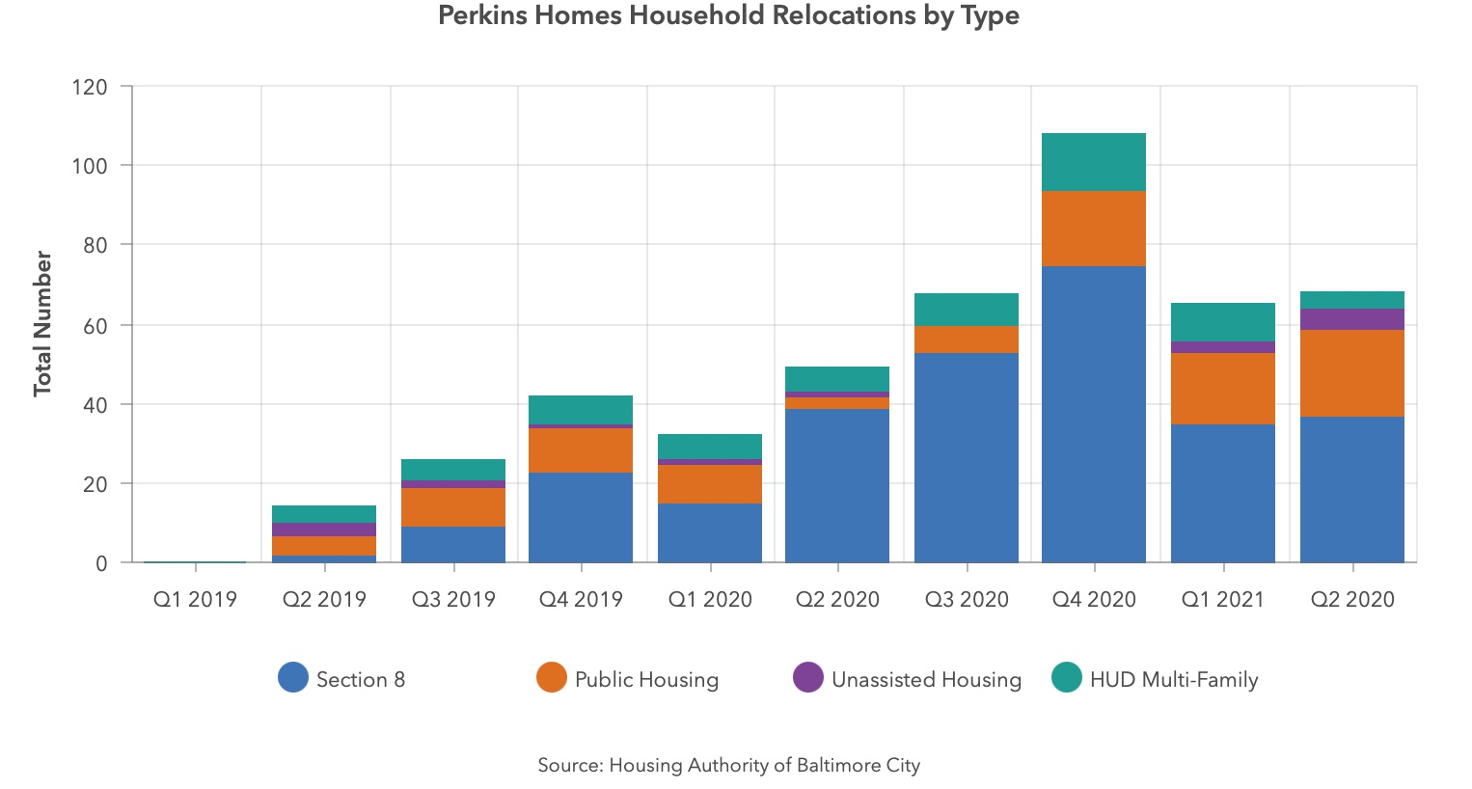
People – Relocations by Quarter

Slide 11
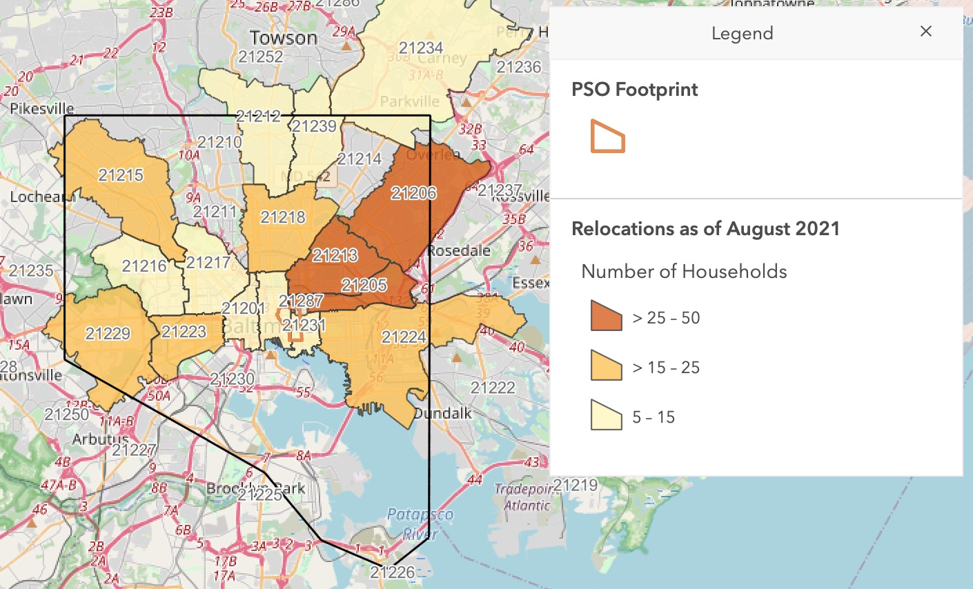
People – Relocations

Slide 12
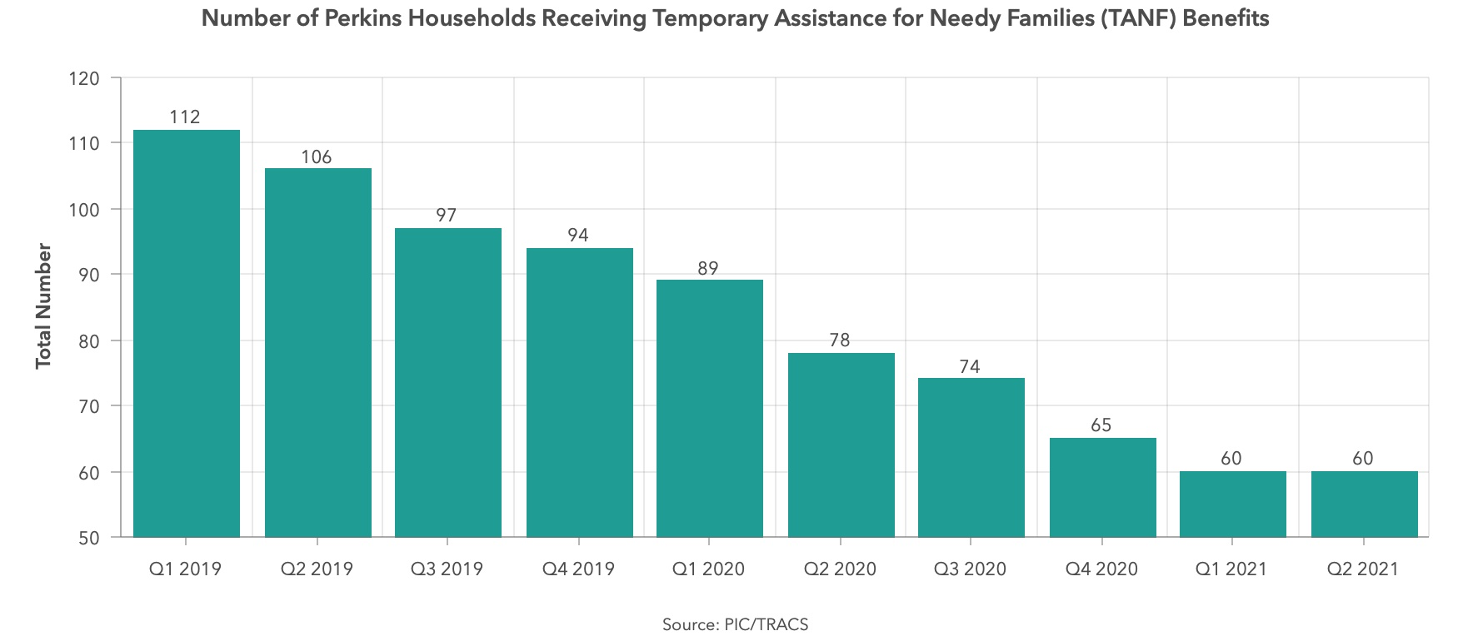
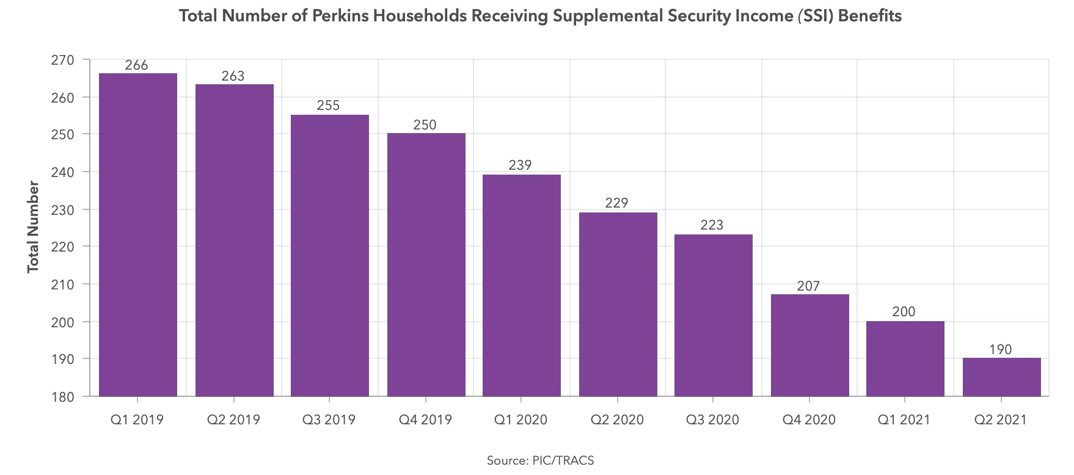
People – Household TANF and SSI Recipients

Slide 13
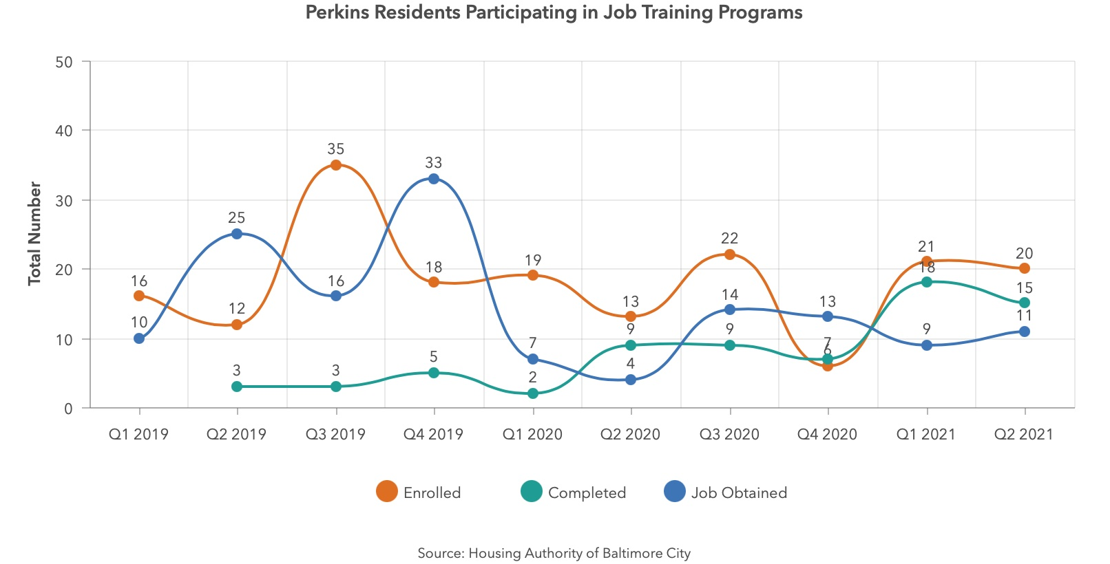
People – Job Trainings Per Quarter

Slide 14
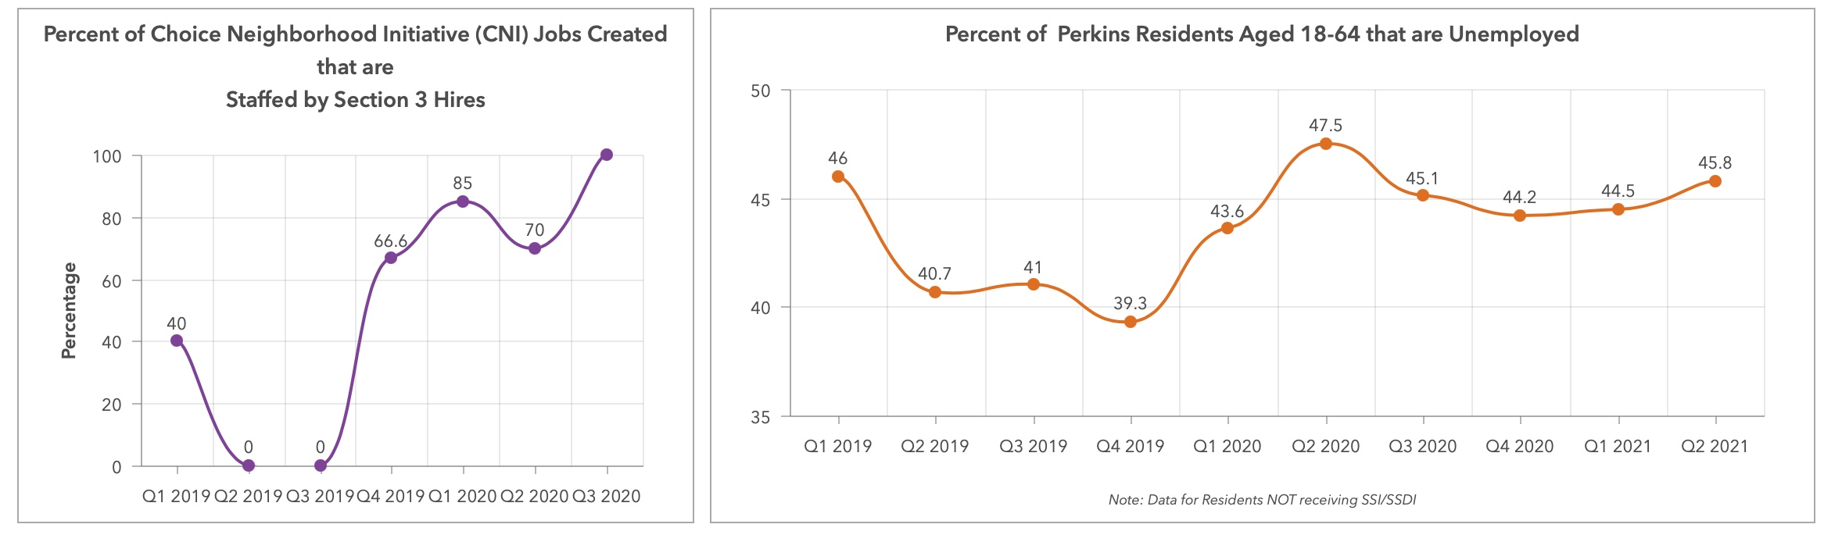
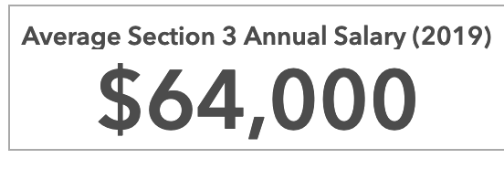
PSO Impact: Jobs

Slide 15
Next Steps
Continue to improve the data dashboard based on residents’ feedback and questions
Get more data to help answer residents and other stakeholders questions
Prepare for next meeting with residents
For any questions, please contact us at anytime at
  bnia-jfi@ubalt.edu

