Slide 1
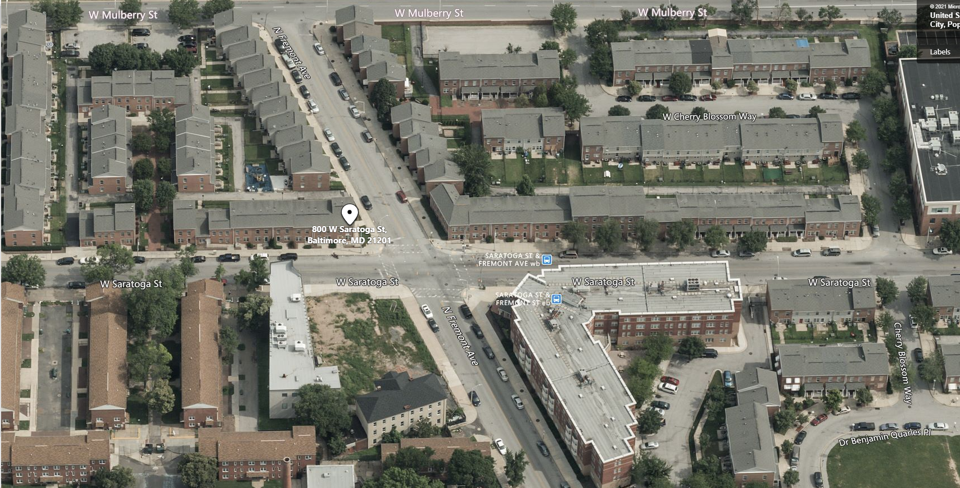
Town of the terraces
RAD conversion & rehab update
September 15, 2021

Slide 2
Team
Rehab Scope Of Work
Mikesell & Associates Architect
Bill Mikesell & Ed Amato
Construction manager
Alicia Biasotti
Relocation planning
Bridget hooper

Slide 3
WHAT IS RAD??

Slide 4
Rehabilitation scope of work
APARTMENT INTERIORS
Kitchens
Replace Cabinets, Countertops & Sinks, Refrigerators, Stoves & Exhaust Hoods & Flooring
Bathrooms & Powder Rooms
Replace Vanities & Sinks, Medicine Cabinets, Mirrors, and Accessories, Bathtubs and Ceramic Tile Surrounds, Porcelain Tile Flooring
Doors, Frames, Hardware & Miscellaneous
Replace Doors, Frames& Hardware as needed
Replace Closet Shelving & Rods as needed
Walls & Ceilings
  Repair Surfaces & Paint
Flooring
  Remove carpet and replace finish flooring
Replace Washers & Dryers
Mechanical Systems
Replace Heating/Cooling Units
Replace Interior Registers
Replace Thermostats
Replace Bathroom Exhaust Fans

Slide 5
Rehabilitation scope of work
APARTMENT INTERIORS
Clean All Ductwork
Plumbing
  Replace All Water Heaters Including Valves
Electrical System
Replace Light Fixtures
Switches & Cover Plates
Outlets & Cover Plates
Fire Alarms
Replace All Detectors & Horns/Strobes
Chair Lifts
Service & Repair In Accessible Units

Slide 6
Rehabilitation scope of work
APARTMENT EXTERIOR
Roofing
Replace Asphalt Shingles, Gutters & Downspouts
Exterior Entrance Doors as needed
Apartment Entry Doors & Hardware, Door Frames, and Storm Doors
Apartment Windows – Repairs
Replace All Broken Window Glass
Repair Damaged Window Screens
Replace Broken Window Screen Frames
Porches – Repairs
Install New Deck Planks
Replace Damaged Column Covers
Masonry Cleaning – Power Wash All Exterior Masonry

Slide 7
Rehabilitation scope of work cont…
SITEWORK
Playgrounds – Repairs/Replacement
Equipment
Retaining Railroad Ties
Resilient Surfaces Replacement
Exterior Lighting
  Replace damaged site lighting
Paving – Repairs
Sidewalks
Curbs
Pavement Surfaces

Slide 8
PROJECT “PRELIMINARY SCHEDULE”
Financing
March 2022
Construction
Phase 1
April 2022- August 2022
Phase 2
September 2022- January 2023
Phase 3
February 2023- June 2023

Slide 9
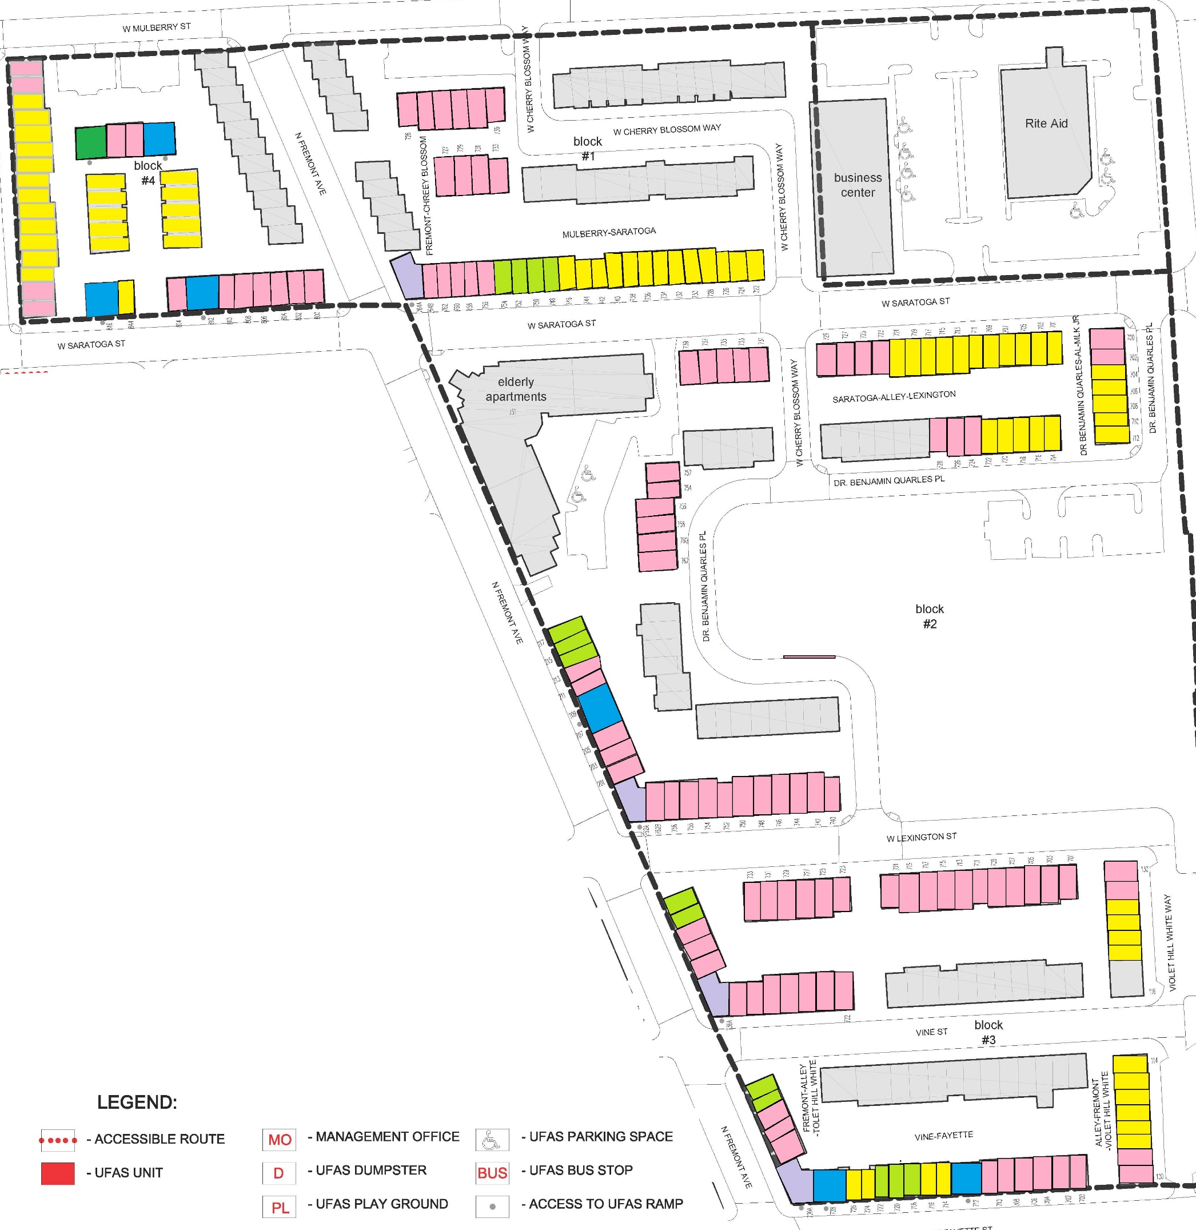
PHASE 1
LEGEND
2 Bedrooms
3 Bedrooms
4 Bedrooms
2 Bedroom UFAS & 2 Bedroom Flat
3 Bedroom UFAS
4 Bedroom UFAS
PHASE 2
PHASE 3
PROJECT PHASING Plan

Slide 10
  QUESTIONS?

