Slide 1
The POE HOMES TRANSFORMATION plan BriefinG
September 15, 2021

Slide 2
HUD Decisions about Action Activity grants
Request for Proposals issued in late 2019
Submitted Action Activity proposals to HUD in June 2020
$950,000 “Action Activity” grant from HUD
Splash Pad at Greater Model Park;
Residential Façade/Aging in Place improvements;
Hollins Market;
Balt. Development Corporation – corner stores;
Balt. Development Corp (BDC) – grocery store;
Notes:
The HUD grant combined with an HABC cash match will award up to $1,235,000 for “Action Activities” to support capital improvements in the area.
HABC contributing $285,000 in project support ($45,000 for the splash pad & $240,000 for the homeowner grants)
The Action Activities RFP generated thirty (30) project proposals (1 was rejected as it was submitted after the deadline).
The four (4) resident associations that ranked the 29 proposals, follow: Hollins Roundhouse; Townes at the Terraces HOA and Townes Tenant Council; Poe Homes Tenant Council; and Poppleton NOW!
The resident associations finalized their scoring on February 28, 2020
We received HUD’s grant decisions (March 16)
HUD has issued a “conceptual approval” to all 5 top-scoring proposals

Slide 3
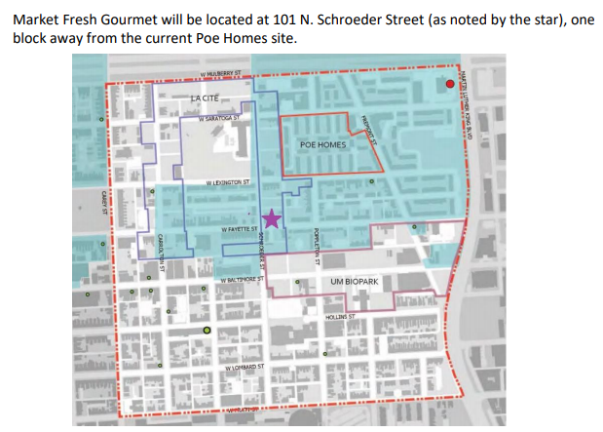
New grocer - poppleton

Slide 4
Project schedule – now to opening

Slide 5
About the grocery store

Slide 6
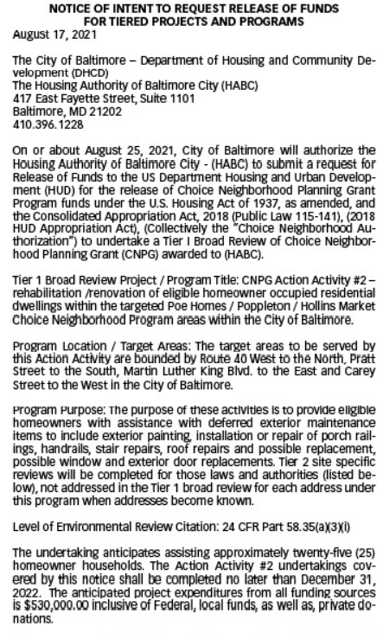
Homeowner grants - rebuilding together

Slide 7
The Choice Neighborhoods Transformation Plan for the Poe Homes, Poppleton and Hollins Market area
Awarded $1.3M in September 2018
$350,000 planning grant from HUD
$950,000 “Action Activity” grant from HUD
Splash Pad at Greater Model Park; Residential Façade/Aging in Place improvements; Hollins Market redevelopment; Healthy Corner Store & Grocery Store
The Planning Process included 2 years of resident and community engagement with public housing residents, property owners, other renters, UMB Biopark and other stakeholders
Submitted Transformation Plan to HUD in September 2020

Slide 8
Status of habc’s acquisitions
HABC owns 800 W. Lexington (Poe Homes)
Acquired:
901 W. Mulberry (surplus Church property) – Spring 2020
Desired Acquisitions:
811 W. Saratoga (vacant former Church)
City-owned properties via land swap
Notes:
HABC will document the list of all households living at Poe Homes on the date of submittal of its plan to HUD.

